Slide 1
Analyzing Microarray Data

Slide 2
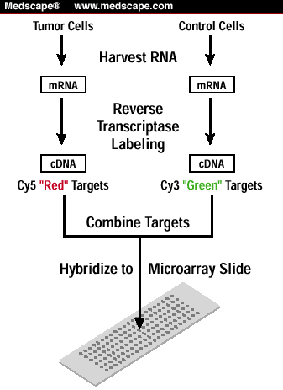
Microarray Technique

Slide 3
One vs Two Channel Microarray
One Channel Data: In one-color microarrays, the arrays provide intensity data for each probe or probe set indicating a relative level of hybridization with the labeled target.
Two Channel Data: Two-color microarrays are typically hybridized with cDNA prepared from two samples to be compared (e.g. diseased tissue versus healthy tissue) and that are labeled with two different flurophores.

Slide 4
Different software's available:
TM4: http://www.tm4.org/
Partek: http://www.partek.com/
SAM: Statistical Analysis Suite Excel plug-in
Biometric Research Branch (BRB) tool: http://linus.nci.nih.gov/BRB-ArrayTools.html
Ingenuity: http://www.ingenuity.com/data-analysis/microarray-data
Cytogenomics Software: http://www.genomics.agilent.com/en/CGH-Microarray-Data-Analysis/CytoGenomics-Software/?cid=AG-PT-111&tabId=AG-PR-1017
GeneSpring GX Software: http://www.genomics.agilent.com/en/Microarray-Data-Analysis-Software/GeneSpring-GX/?cid=AG-PT-130&tabId=AG-PR-1061
Illumina Systems Sofware: http://www.illumina.com/404.aspx?errorpath=http://www.illumina.com/products/systems/systems_software.ilmn
dCHIP: http://www.hsph.harvard.edu/cli/complab/dchip/

Slide 5

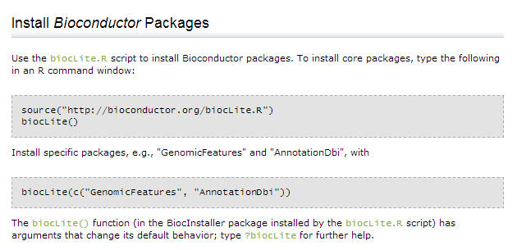

Programming tools:
http://www.ncbi.nlm.nih.gov/pmc/articles/PMC3087835/
http://cran.r-project.org/bin/windows/base/
http://www.bioconductor.org/

Slide 6
Data Formats:
Expression Data Formats
1.1 GCT: Gene Cluster Text file format (*.gct)
1.2 RES: ExpRESsion (with P and A calls) file format (*.res)
1.3 PCL: Stanford cDNA file format (*.pcl)
1.4 TXT: Text file format for expression dataset (*.txt)
1.5 .CEL: Cel file format for expression dataset (*.CEL)
Phenotype Data Formats
2.1 CLS: Categorical (e.g tumor vs normal) class file format (*.cls)
2.2 CLS: Continuous (e.g time-series or gene profile) file format (*.cls)
Gene Set Database Formats
3.1 GMX: Gene MatriX file format (*.gmx)
3.2 GMT: Gene Matrix Transposed file format (*.gmt)
3.3 GRP: Gene set file format (*.grp)
3.4 XML: Molecular signature database file format (msigdb_*.xml)
Microarray Chip Annotation Formats
4.1 CHIP: Chip file format (*.chip)
Ranked Gene Lists
5.1 RNK: Ranked list file format (*.rnk)
http://www.broadinstitute.org/cancer/software/gsea/wiki/index.php/Data_formats

Slide 7
Data Analysis Steps:
Image analysis:
Data processing: background subtraction, determination of spot intensities and intensity ratios, visualization of data (MA Plot), log-transformation of ratios, normalization of intensity ratios.
Class discovery analysis: unsupervised classification techniques, k-means cluster analyses, hierarchical cluster analysis.
Class prediction analysis: supervised classification, linear regression.
Hypothesis-driven statistical analysis: Identification of statistically significant changes in gene expression are commonly identified using the T-Test, ANOVA.
Dimensional reduction: principal components analysis (PCA)

Slide 8
Normalization:
Normalization is needed to ensure that differences in intensities are indeed due to differential expression, and not some printing, hybridization, or scanning artifact.
Normalization is necessary before any analysis which involves within or between slides comparisons of intensities.
Normalization is different in one/two-color (cDNA) and high-density-oligonucleotides (Affy) technologies.

Slide 9
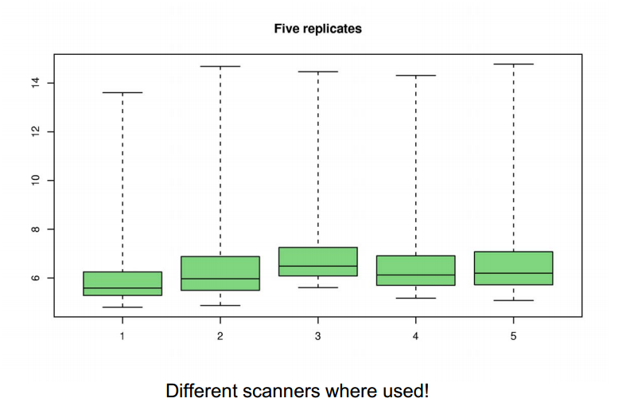
Why Normalize?

Slide 10
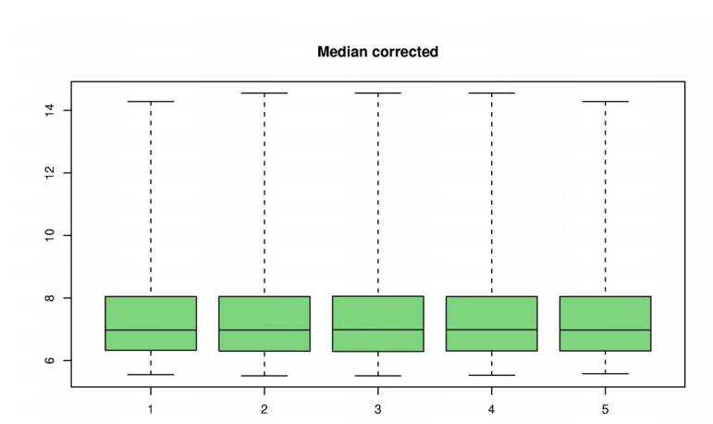
After Normalization:
Use control genes to adjust
Assume most genes are not differentially expressed
Assume distribution of expression are the same

Slide 11
Perfect Match and Mismatch Probe:
Single square-shaped feature on an array containing probes with a unique sequence. The size can vary depending on the array type, typically 20 µm or 18 µm. Each probe cell contains millions of probe molecules. Perfect Match (PM) Probes that are designed to be complementary to a reference sequence.
Mismatch (MM) Probes that are designed to be complementary to a reference sequence except for a mismatch at the central position (e.g., 13th position of 25 base probe). Mismatch probes serve as a control for cross-hybridization.
The mismatch should not hybridize and should detect non-specific hybridization and local background providing a local control to compare the perfect match with.

Slide 12
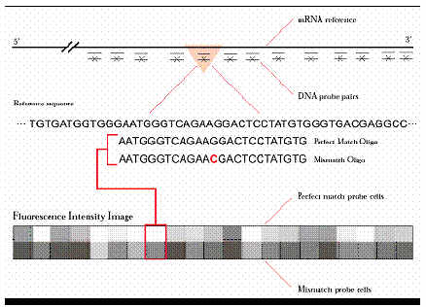
PM and MM:

Slide 13
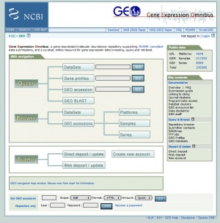
Data Collection:
One/Two channel micro array data available at Gene Expression Omnibus (GEO) database and Genome Atlas (TCGA)

Slide 14
Need for normalization and RMA
Normalization is needed to ensure that differences in intensities are indeed due to differential expression, and not some printing, hybridization, or scanning artifact.
Robust Multiarray Normalization (RMA):
1) Background correction.
2) Normalization.
3) Probe level intensity calculation.
4) Probe set summarization.

Slide 15
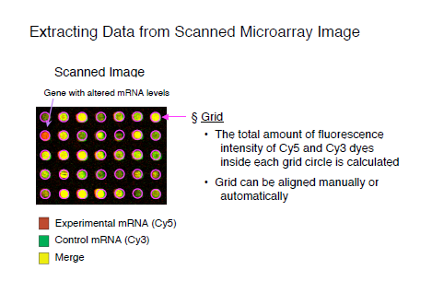
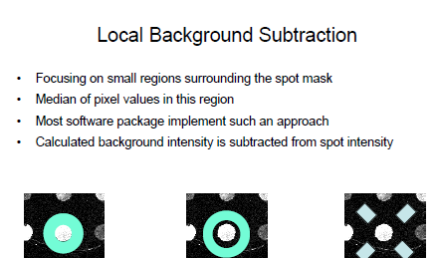
1) Background correction.
ScanAlyze ImaGene Genepix

Slide 16
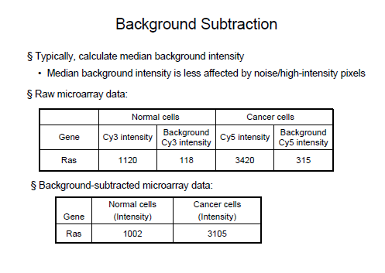
1) Background correction.

Slide 17
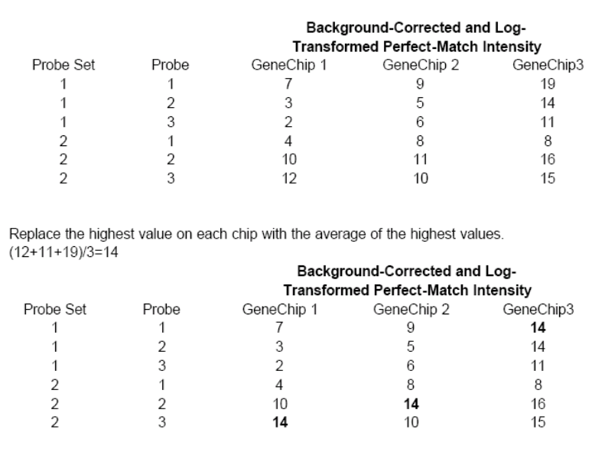
2) Normalization: Quantile normalization:

Slide 18
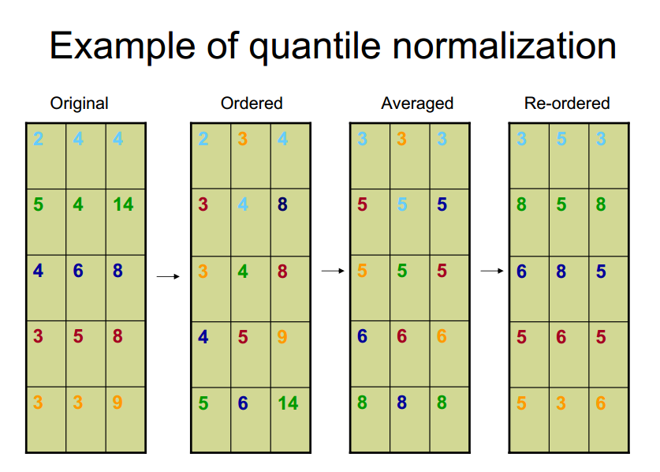

Slide 19
3) Probe level intensity calculation.
A linear model is fit to the normalized data to obtain an expression measure for each probe on each GeneChip. The linear model for a particular probe set can be written as
Yij = mi+aj+eij
(Yij denotes the normalized probe value corresponding to the ith GeneChip and the jth probe within the probe set
mi denotes the log-scale expression for the probe set in the sample hybridized to the ith GeneChip
aj denotes the probe affinity effect for the jth probe within the probe set
eij denotes a random error term)

Slide 20
4) Probe set summarization:
Tukey's median polish should make all row and column medians to zero. Fitted values can be calculated by subtracting this matrix from original to get RMA normalized intensities.

Slide 21
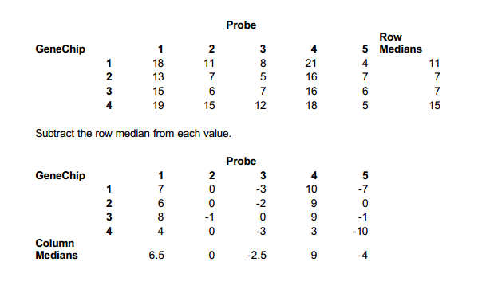
4) Probe set summarization:

Slide 22
Median Polish?
All row medians and column medians are 0. Thus the median polish procedure has converged. The above is the residual matrix that we will subtract from the original matrix to obtain the fitted values.

Slide 23
Advantages:
Rigid model: defines model then tries to fit experimental data to the model. Fewer fudge factors than other normalization techniques
Disadvantages:
Does not provide “calls” (Present (P), Absent (A) which detects if the hybridization has occurred or not)
Misc:
Requires multiple samples

Slide 24
Affymetrix® Microarray Suite (MAS) 5.0 Normalization:
MAS5 normalises each array independently and sequentially; RMA as the name suggests (robust multi-array) uses a multi-chip model
MAS5 uses data from mismatch probes to calculate a "robust average", based on subtracting mismatch probe value from match probe value
MA values are in log2 units, MAS5 are not (so values are not directly comparable)

